Slide 1
Fast Algorithm for Modularity-Based Graph Clustering Algorithm
Group #7
Vamsi Angajala
Raja Mummidi
Kshitija Joshi
Bharadwaj Aryasomayajula

Slide 2
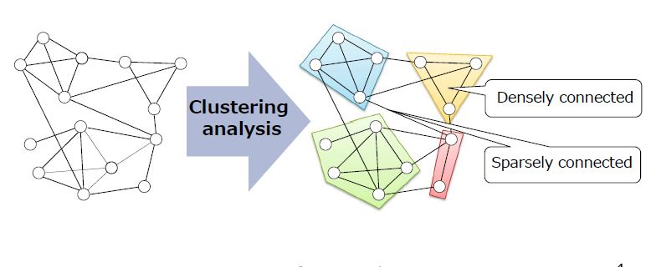
Graph Clustering

Slide 3
Graph Clustering
Finding natural groupings or clusters or communities within graphs.
Community detection over social networks
Facebook: 1.11 billion active users / month
Twitter: 140 million active users / day
340 million new posts / day
Massive data require lot of time for analysis
It is important to analyze large scale data quickly

Slide 4
Improvement of clustering speed
Girvan-Newman method [Girvan et al., 2004]
10k nodes/hour
Newman method [Newman et al., 2004]
100k nodes/hour
CNM [Clauset et al., 2004]
1M nodes/hour
BGLL [Blondel et al., 2008]
10M nodes/hour
Research Target: 1B 〜100M nodes/hour

Slide 5
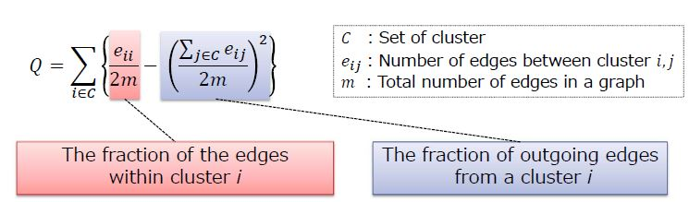
Modularity
Modularity evaluates the strength of division of a graph into clusters.
Higher is the modularity better is the clustering.

Slide 6
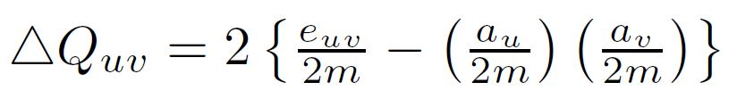
Modularity Gain
Modularity gain is the measure we use to check whether the vertices can be part of a cluster.
Formula for calculation:
e_{u,v} : total number of edges between cluster u and v;
a_{u} : total number of edges that are attached to vertices in cluster u.

Slide 7
Modularity-Based Graph Clustering Algorithm
Three Key Technique:
Incremental aggregation
Incremental pruning
Efficient ordering
Practical concepts:
Clustering coefficient: A measure of degree to which nodes
in a graph tend to cluster together
Power-law degree distribution

Slide 8
Incremental Aggregation
Take the selected vertex.
Find the vertex with max modularity gain, among the neighbours of the selected vertex.
If the max modularity gain is negative, prune that vertex from the set of target vertices.
If it is positive, merge the vertex with the selected vertex.
Merging?

Slide 9
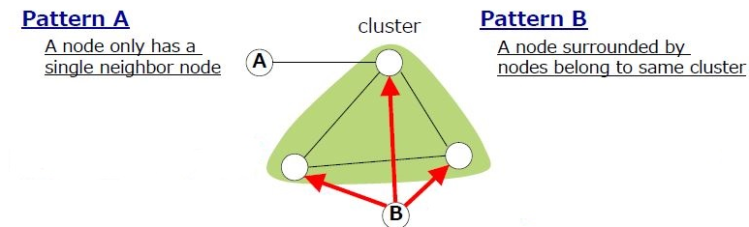
Incremental Pruning
Incrementally prune nodes with only one neighbour.
By pruning I mean, we assign them to that only neighbour’s cluster, i.e merge it with that neighbour vertex.

Slide 10
Efficient ordering of node selection
Select the node, with the smallest degree, for the next iteration.
By selecting node with the smallest degree, we can avoid producing super-cluster structures(clusters of clusters).
This ensures that we have minimum number of modularity gain computations.

Slide 11
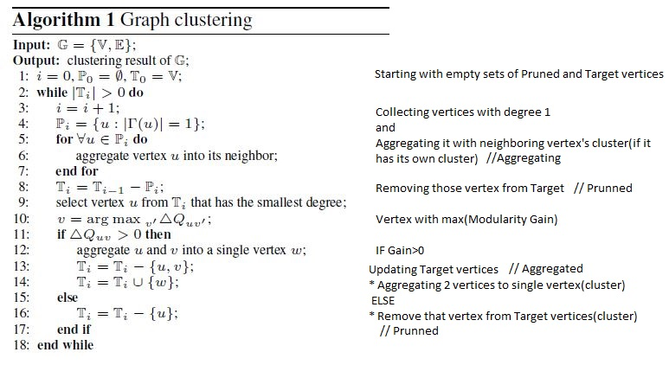
Algo
Algorithm

Slide 12
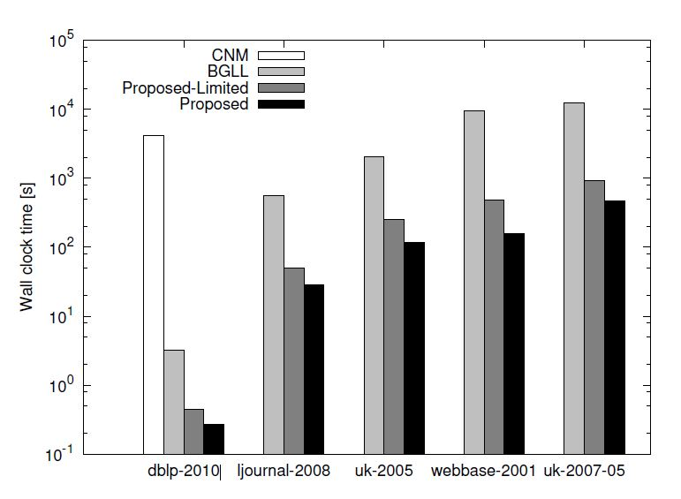
Results : Improved clustering speed

Slide 13
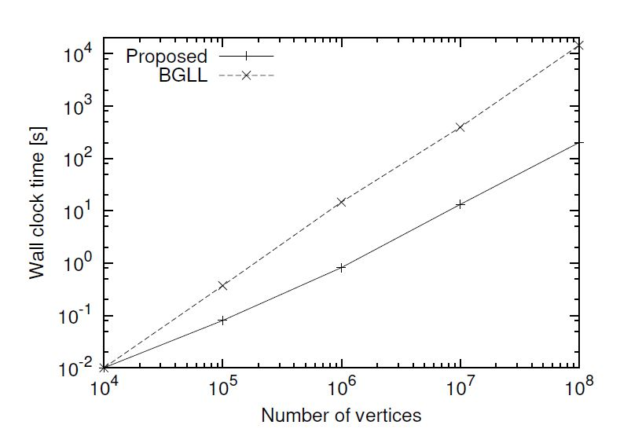
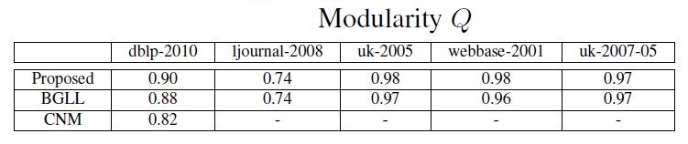

Slide 14
References
Fast Algorithm for Modularity-Based Graph Clustering :
Hiroaki Shiokawa, Yasuhiro Fujiwara and Makoto Onizuka NTT Software Innovation Center, Nippon Telegraph and Telephone Corporation, 2011.
nwds.cs.washington.edu

Slide 15
Thank You

